Slide 1
Mobile Technologies:
The Past, Present and Future.
(LP20539A1)
Keiran Saxty,
City of Bath College

Slide 2
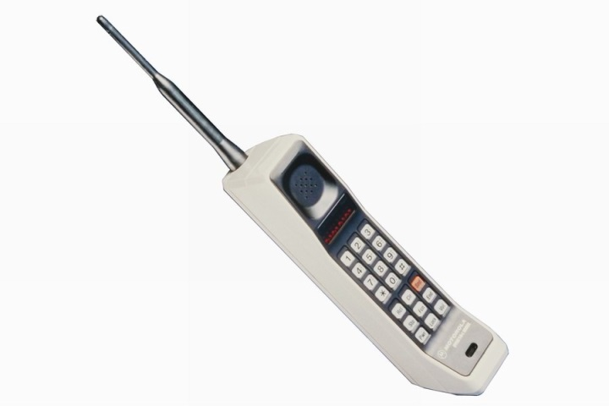
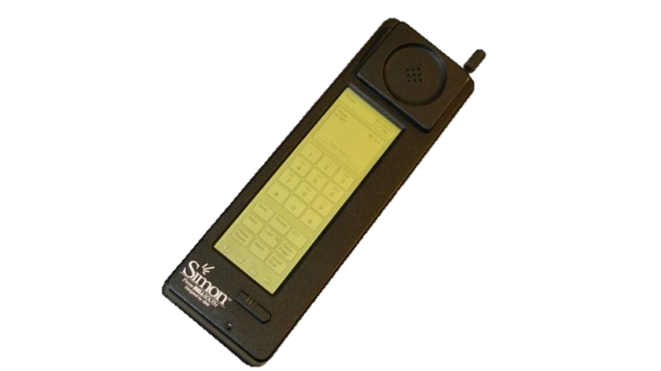
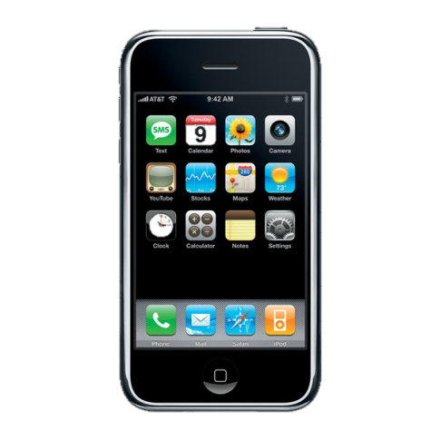

The Past
Motorola Handset (1973)
Motorola DnyaTAC 8000x (1983)
IBM Simon Personal Communicator (1994)
Symbian OS (1997)
iPhone (2007)
Notes:
The first ever mobile phone was created by John F. Mitchell and Martin Cooper of Motorola in 1973; the handset weighed 4.4lbs (2 kg).
The DynaTAC 8000x, released in 1983, was the first ever commercially-available handheld mobile phone.
The IBM Simon Personal communicator released in 1994 was the first cellular device that can be referred to as a ‘smartphone’. The term ‘smartphone’ was actually first used in 1995 to describe AT&T’s “PhoneWriter Communicator”.
Symbian was the most popular smartphone OS in Europe during the middle to late 2000s until handset manufacturers began to use other new operating systems such as Windows Phone OS and Blackberry OS. Once Nokia started to adopt Windows Phone OS, Symbian was phased out and it now holds a very small percentage of the mobile operating system market share.
The iPhone was announced in 2007, its operating system iOS was designed and build by Apple Inc. exclusively for use on Apple hardware. The first-generation iPhone went on to sell 6.1 million units over the first five quarters since its release and it revolutionised the smartphone industry, paving the way for new paradigms in handset and mobile operating system design.

Slide 3
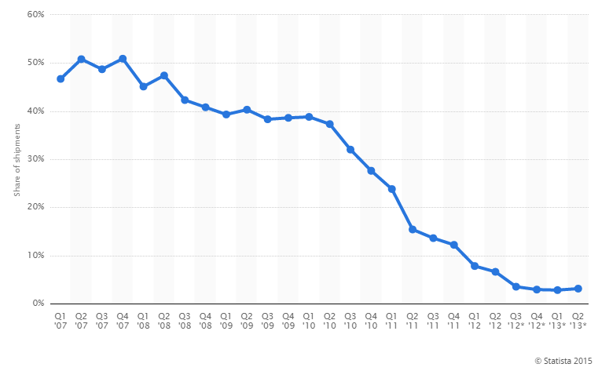
Nokia smartphone market share (2007 – 2013)
Notes:
Nokia smartphone market share (2007 -2013) – The graph shows that in the span of six years, Nokia went from having a market share of approximately 50% to that of just under 5%.
This declining trend began in the year that Apple introduced the iPhone which shows that the iPhone had a major impact on the smartphone industry. (Statista, 2015)

Slide 4
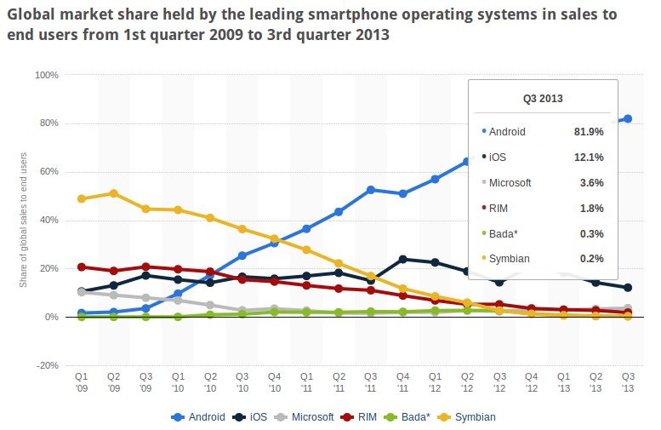
Mobile operating system
Market Share (2009 – 2013)
Notes:
Mobile operating system
Market Share (2009 – 2013)
The chart above shows the market shares of each mobile operating system between 2009 and 2013.; the chart clearly shows that Android’s market share is increasing consistently where as the others’ are declining. (Sourcedigit.com, 2015)

Slide 5
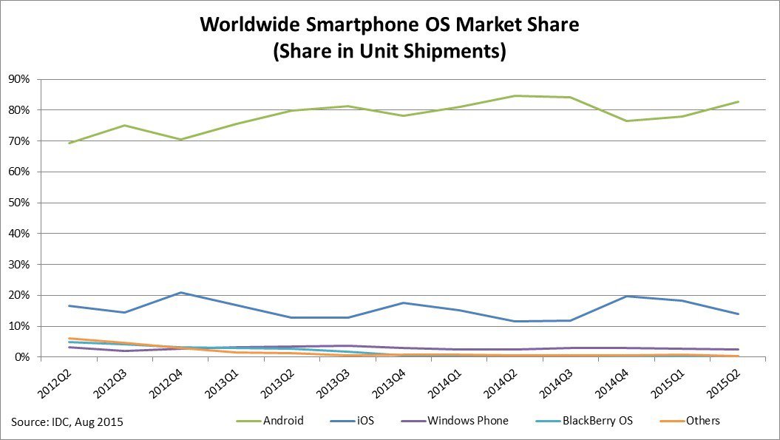
The Present – Current Mobile OS Market Share
(2012 – 2015)
The number of mobile devices is set to exceed the total word population by the end of this year.
Notes:
Worldwide Smartphone OS Market Share – This graph displays the market share for each major mobile operating system. The graph shows that Android has a consistently much higher market share than the other operating systems and appears to be increasing where as the market shares of others such as iOS either stay approximately the same or decrease.

Slide 6
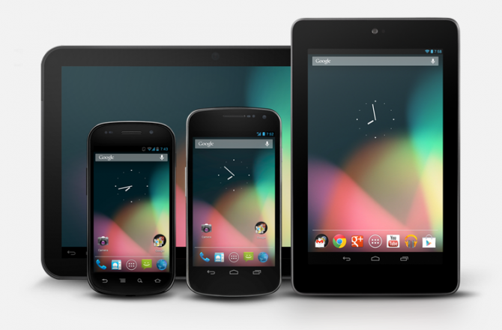
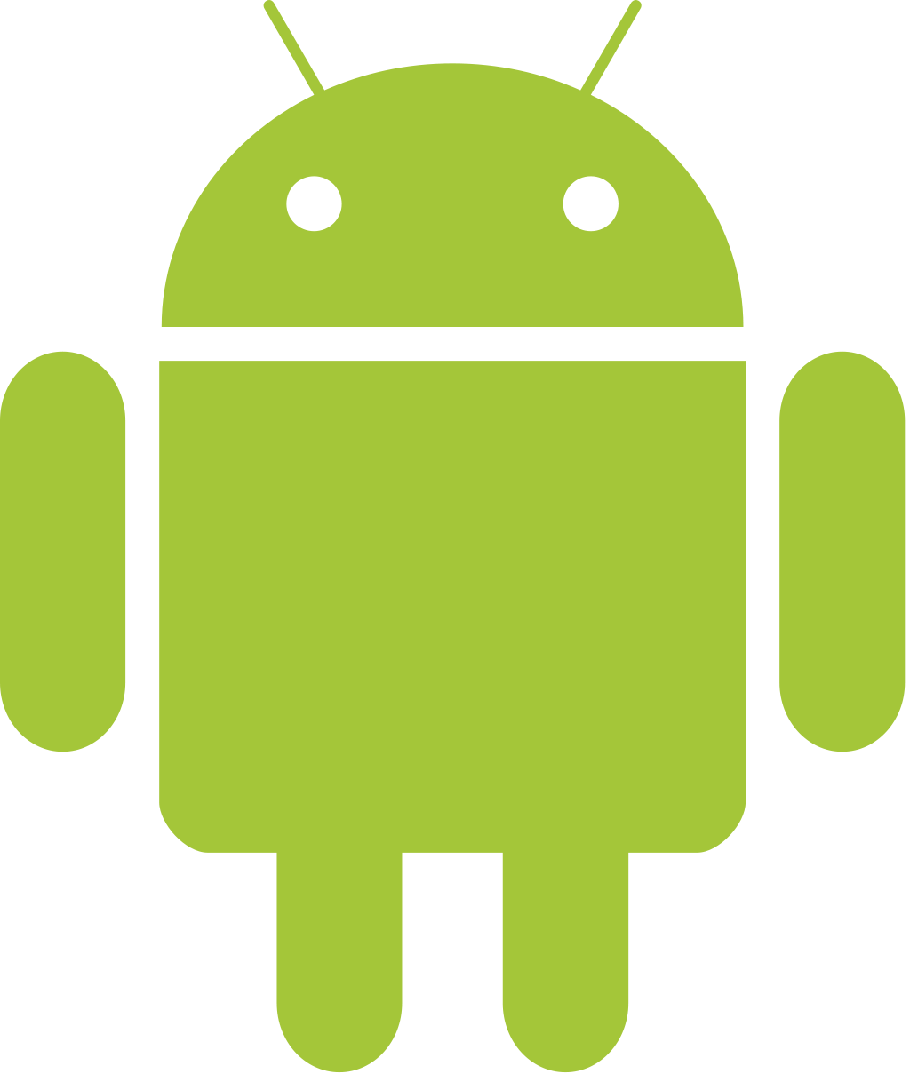
Android OS
Notes:
Android OS was created by Android Inc.; not long after starting development, the company was bought out by Google who then oversaw development of the OS.
By the third financial quarter of 2012, Android OS had a 75% share of the global smartphone market.
Additionally, as of this year (2015),android has the largest installed base of any operating system.
Android was original designed to run on ARM processors and then support for Intel x86 processors was added fairly soon after. Due to this flexibility, android can be run on a wide range of hardware.
The main reasons why Android is so popular are:
Android smartphones are typically less expensive/more affordable (not always)
Android is versatile, easy to create something for a new/ different platform
Because Android is open source, more developers can create content which leads to more choice for consumers. Additionally, having the source code open source allows for collaboration between developers

Slide 7
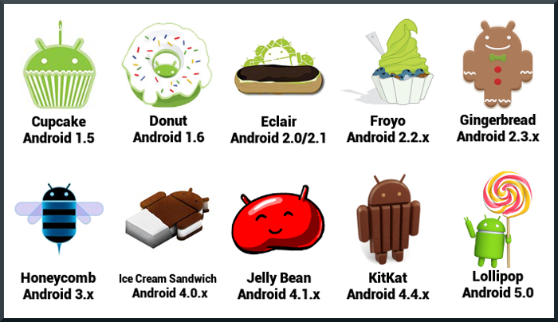
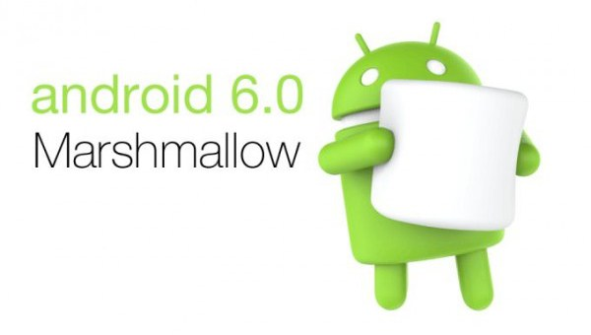
Android OS Version History
Notes:
The image shown is a graphical timeline of versions of the Android operating system. Note: Each version is named after a confectionary-good and arranged alphabetically. The latest version of the Android OS is Marshmallow (version 6.0).

Slide 8
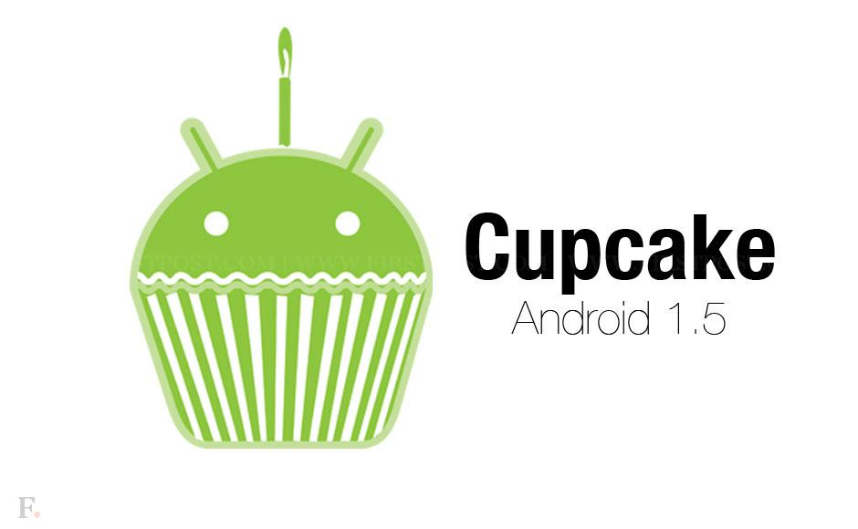
Android OS 1.5 Cupcake
Notes:
Cupcake 1.5 was the first publicly-available version of the Android OS.
Added Features:
Fully-functional touchscreen keyboard
Add video-capture and playback

Slide 9
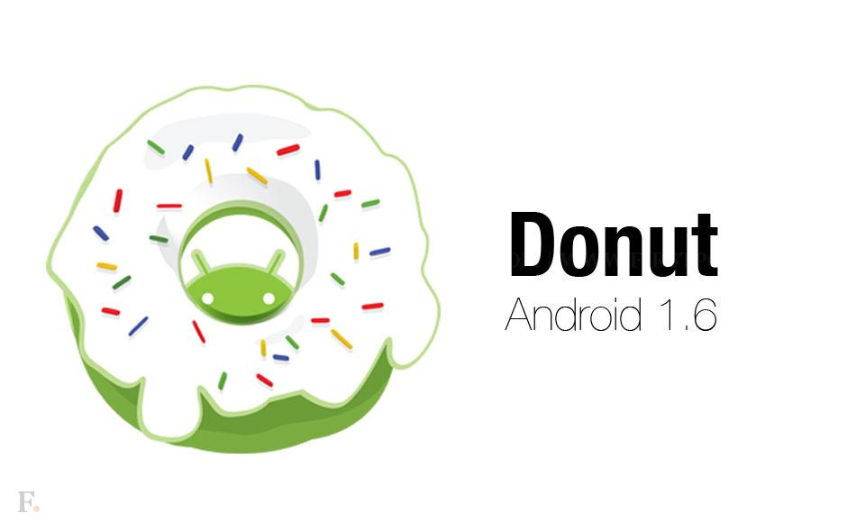
Android OS 1.6 Donut
Notes:
Added Features:
Voice recognition for text entry
Speech synthesis (allows OS to ‘speak’ a text string in various different languages)

Slide 10
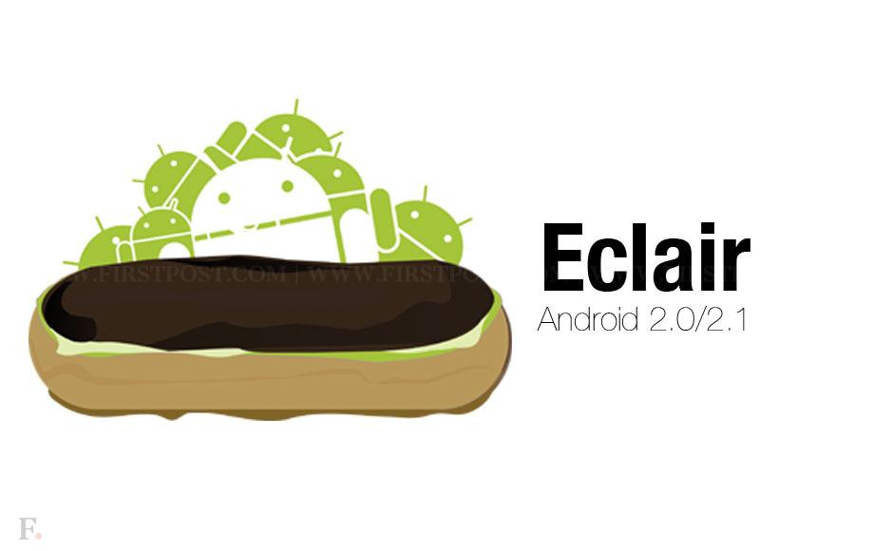
Android OS 2.0 – 2.1 Eclair
Notes:
Added Features:
Improved interface customisation
Allowed display of live wallpapers

Slide 11
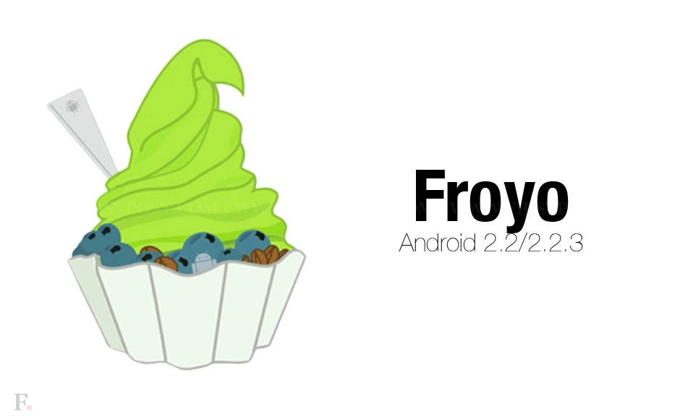
Android OS 2.2 Froyo
Notes:
Added Features:
Allows creation of Wi-Fi Hotspots
USB tethering
Allows toggle of mobile data access

Slide 12
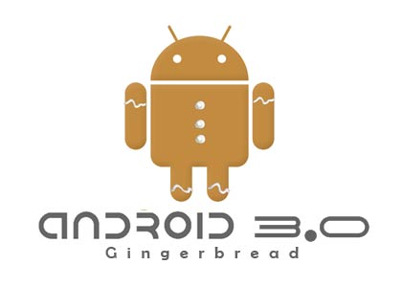
Android OS 2.3 Gingerbread
Notes:
Added Features:
Ability to store applications on SD card instead of phone memory
Added VOIP (Voice Over Internet Protocol) functionality (audio transmission across Internet)
Added NFC (Near-Field Communications)

Slide 13

Android OS 3.0 Honeycomb
Notes:
Added Features:
This version was designed for and only available on tablet computers.

Slide 14
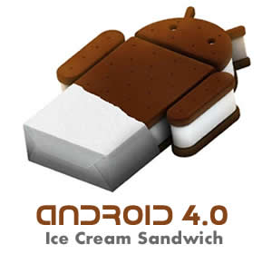
Android OS 4.0 Ice Cream Sandwich
Notes:
Added Features:
New security features (unlock device via face recognition)
Added support for 1080p video recording

Slide 15
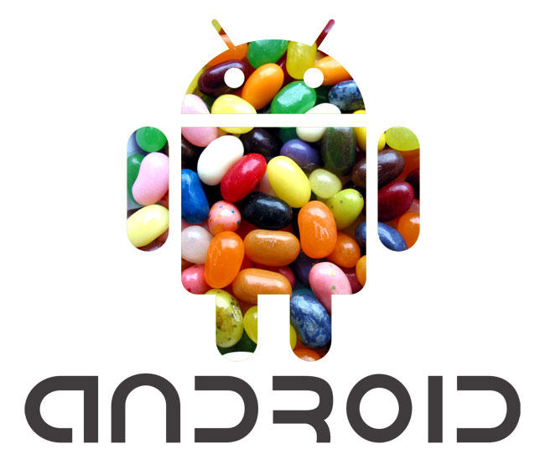
Android OS 4.1 Jelly Bean
Notes:
Added Features:
Multi-channel audio
Improved blue-tooth support
‘Google Now’ feature

Slide 16
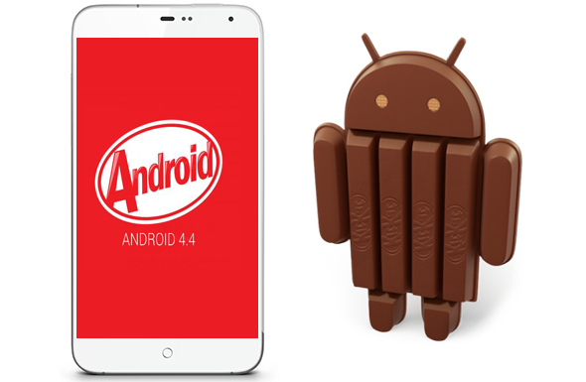
Android OS 4.4 KitKat
Notes:
Added Features:
Support for wireless printing (print document straight from device over network)
Added ‘Ok Google’ feature (allows user to give voice commands)

Slide 17
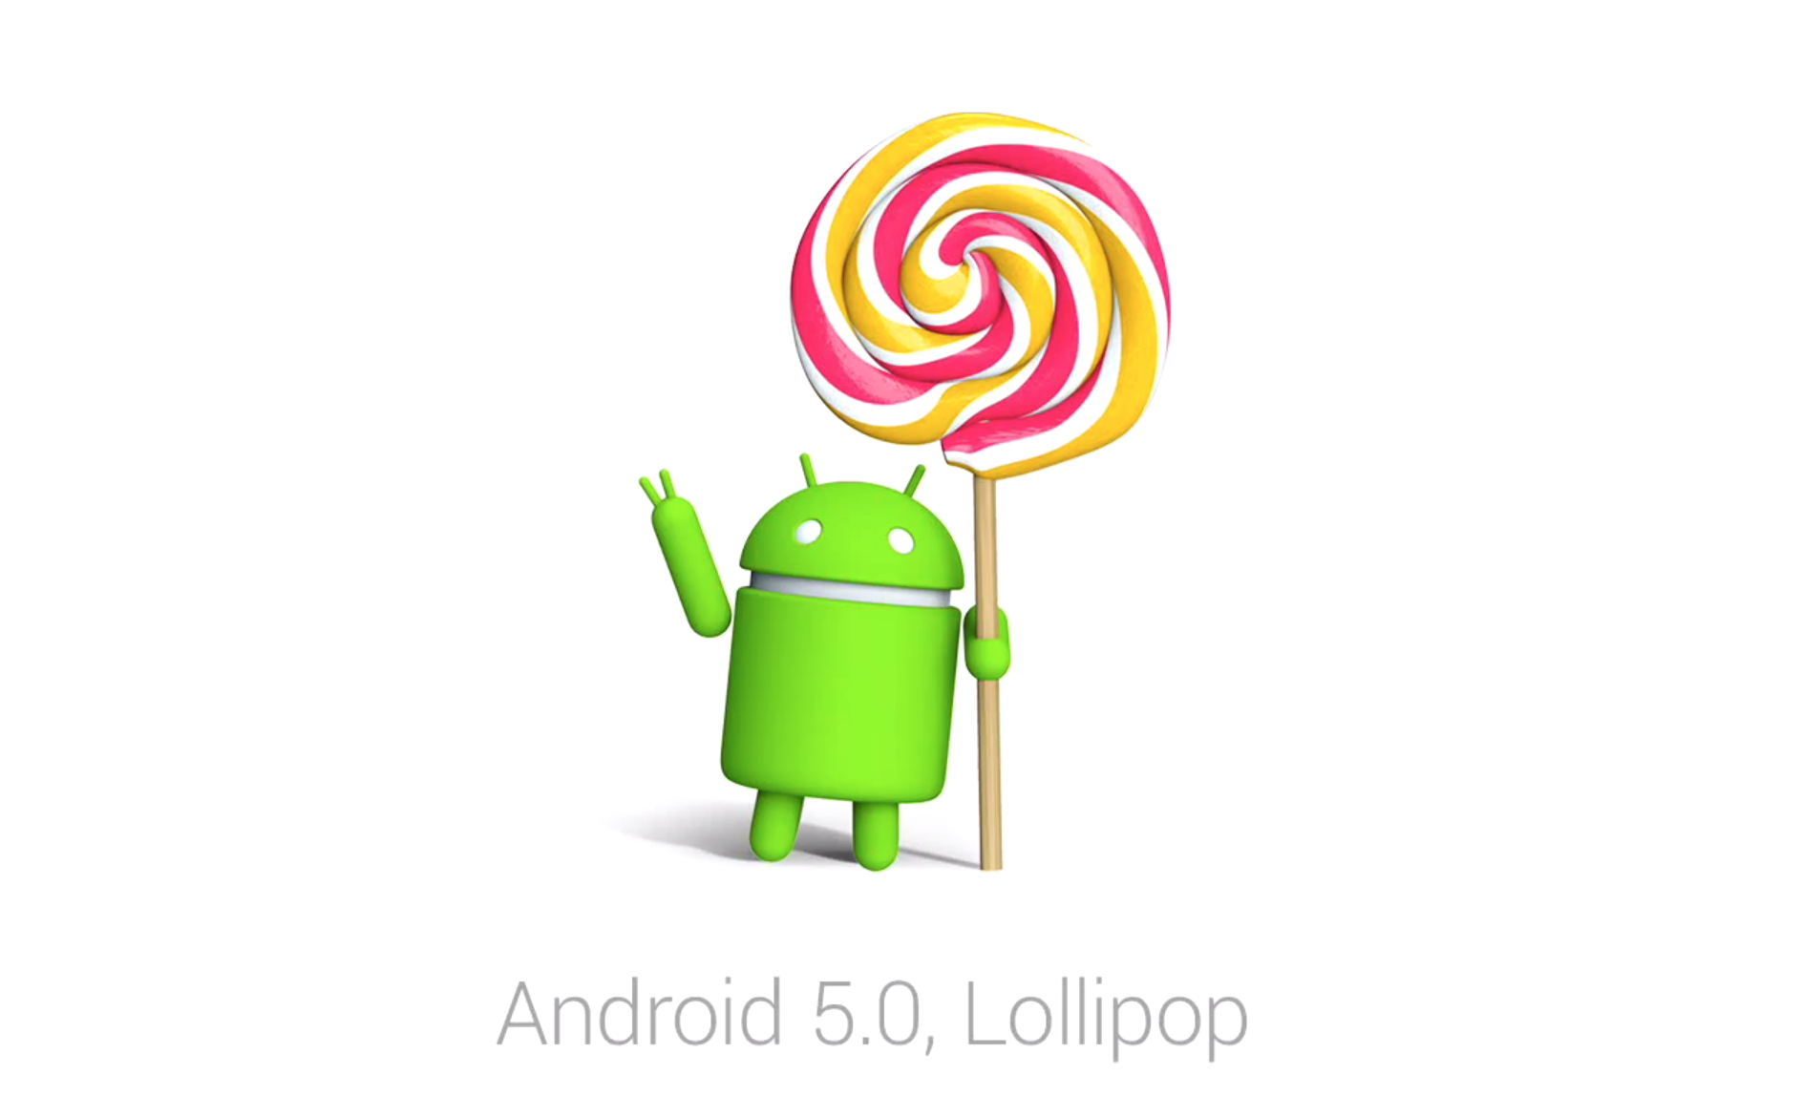
Android OS 5.0 Lollipop
Notes:
Added Features:
Added support for 64 bit CPU
Added support for very big and very small screens (television, etc)
Smartlock feature (unlock device with another device)

Slide 18
Android OS 6.0 Lollipop
Notes:
Added Features:
Introduced ‘Doze’ battery-saving feature (phone goes into standby mode when locked)
Added support for 4k applications
Added support for 4k cameras
Added ‘Google Now Tap’ feature (user taps on the screen and Google will conduct a search based on the context of what is being tapped)

Slide 19
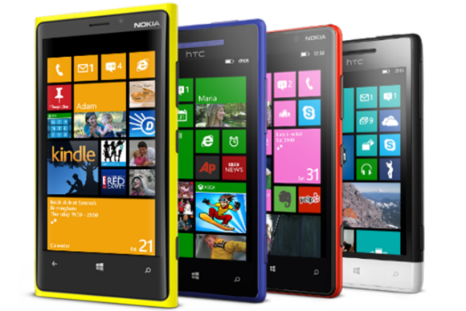

Windows Phone OS
Notes:
Windows Phone OS was released in 2010 and is the most recent upgrade to the existing Windows Mobile OS which was phased out during that year.
Windows Phone OS has a relatively low market share when compared to Android and iOS.
Microsoft purchased Nokia in 2014 and has been manufacturing Nokia smartphones with Windows Phone as the OS.

Slide 20
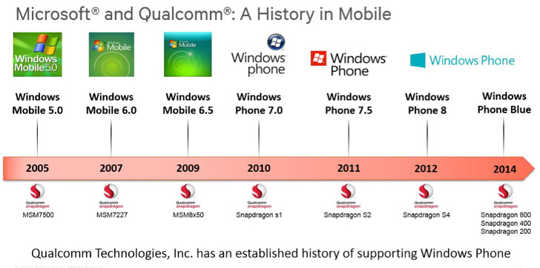
Windows Phone OS Version History
Notes:
The image shows a timeline of the different versions of the Windows Phone operating system, going back to the Windows Mobile OS that Windows Phone OS was based off.

Slide 21
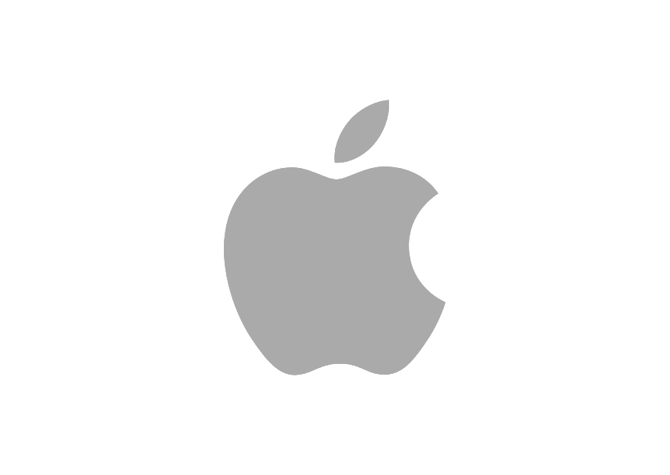
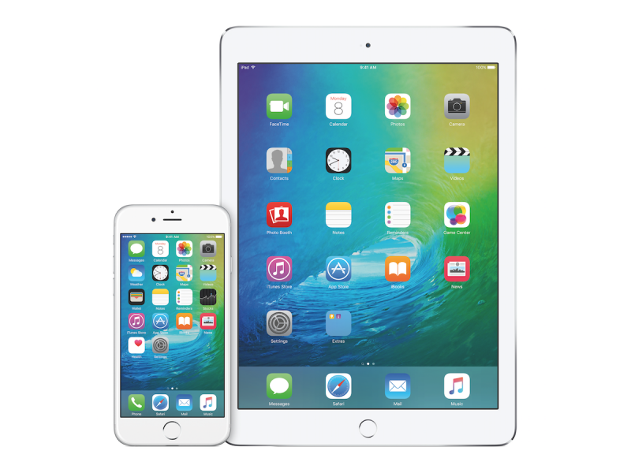
Apple iOS
Notes:
Apple iOS was created and developed by Apple Inc. to run exclusively on Apple hardware.
It is the second most popular mobile operating system in the world, behind Android.
As of 2015, iOS has a market share of 19.7%. However, despite a low market share, it is the most commonly used tablet operating system in the world.
Also in 2015, Apple announced that they have soled over one billion iOS devices since the first-generation iPhone was launched back in 2007.

Slide 22
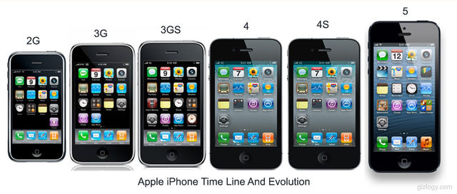
iPhone / iOS Version History
Notes:
The image above shows the evolution of the iPhone and iOS over several generations. One of the consistent changes throughout each iteration is an increased screen size; this alteration started off competition in the industry to produce smartphones with larger and larger display; ultimately leading to the production of ‘phablets’ (a device between the size of a regular smartphone and a tablet).
The interface remains very much unchanged in each version apart from small changes to interface behaviour and the application icons.

Slide 23
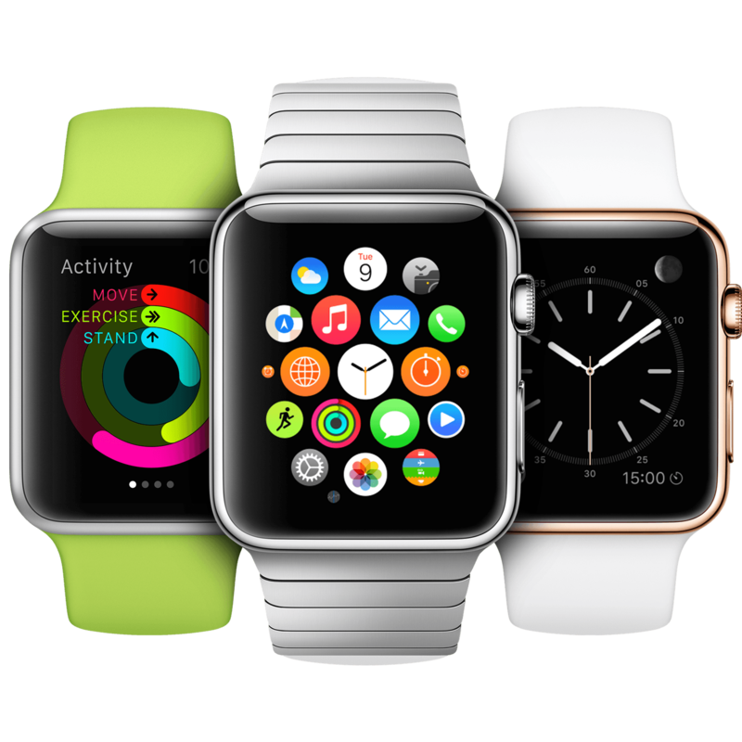
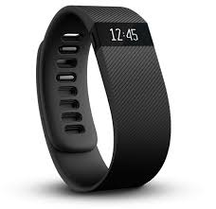
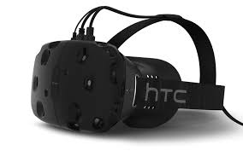
Future of mobile technology – 1 Year
Notes:
Wearables – Wearable technology has become a fairly large industry in the last few years and a field of great interest for many companies. Commercially available wearable technology already exists, i.e. the AppleWatch and GoogleGlass. It is likely that we will see major advancements in this area within the next five years.
Biometrics – Many new mobile devices include sensors that allow them to record biometric data (data about the person, i.e. their heart rate, body temperature) which can then be tracked and analysed by applications for use in a wide range of areas. E.g. fitBit smartwatches record biometric data about the wearer to analyse performance in an exercise regime.
Virtual Reality – Virtual/ augmented reality technology has come on leaps and bounds in the last decade with most VR/AR products to become commercially available in2016/ 2017. E.g. Google Cardboard is an inexpensive piece of VR technology that can be used with most modern mobile devices.
Advanced AI personalities – Advances in data analytics have allowed for the creation of fairly ‘intelligent’ AI personalities such as Apple’s Siri and Microsoft’s Cortana. However, these current AI personalities still need much more work.
Automatic speech translation – In the last decade there have been major advances in speech recognition software which have been integrated into most modern operating systems. However, even Google does not currently have an automatic speech translation service.
Textured/ tactile-feedback displays – Microsoft are currently working on a new touch screen technology that can dynamically change the physical texture of the screen, making buttons raised, etc. This solves the issues of lack of tactile feedback on touchscreens and makes mobile devices more accessible to those with vision impairments as they will be able to feel what it on the screen.
Brain-computer interfacing – Researchers have been working for decades now on brain-computer interfaces; advances have been made in the last decade such as allowing a person to play a game of ‘Pong’ via brainwaves captured through an Electroencephalogram. It is likely that within the next decade, we could have technology that allows us to control mobile devices with the power of thought.

Slide 24
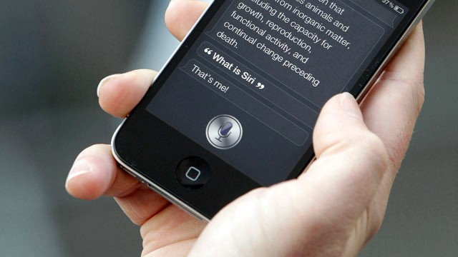
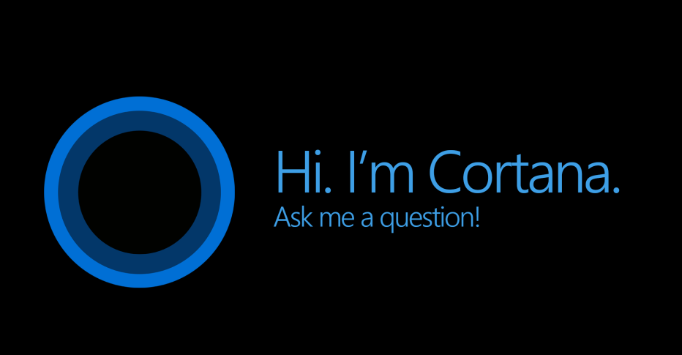
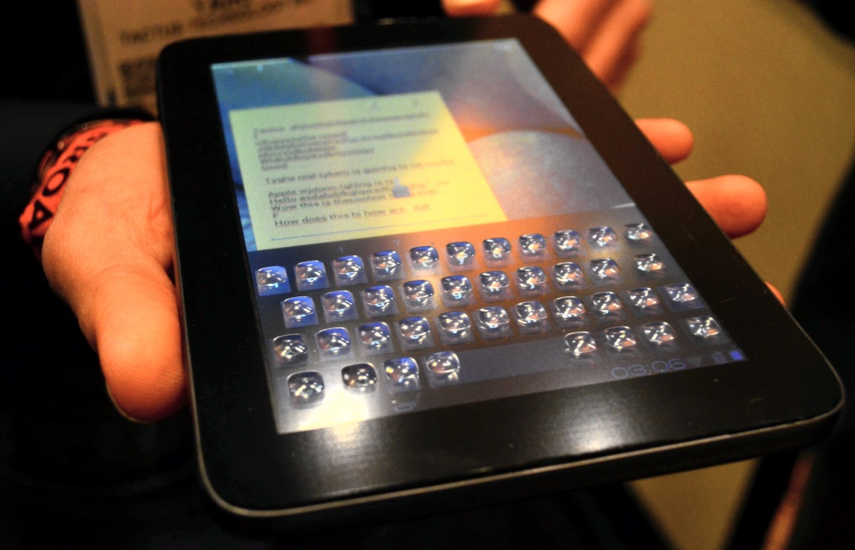
Future of mobile technology – 5 Years
Notes:
Advanced AI personalities – Advances in data analytics and voice recognition have allowed for the creation of fairly ‘intelligent’ AI personalities such as Apple’s Siri and Microsoft’s Cortana. However, these current AI personalities still need much more work.
Automatic speech translation – In the last decade there have been major advances in speech recognition software which have been integrated into most modern operating systems. However, even Google does not currently have an automatic speech translation service.
Textured/ tactile-feedback displays – Microsoft are currently working on a new touch screen technology that can dynamically change the physical texture of the screen, making buttons raised, etc. This solves the issues of lack of tactile feedback on touchscreens and makes mobile devices more accessible to those with vision impairments as they will be able to feel what it on the screen.

Slide 25
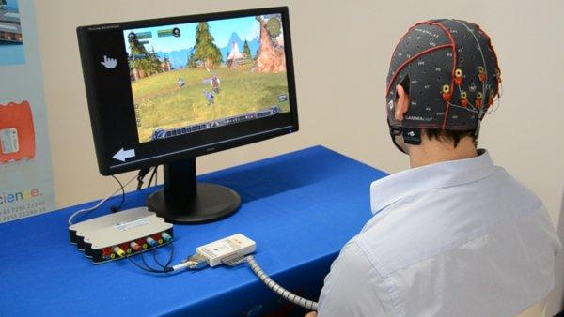
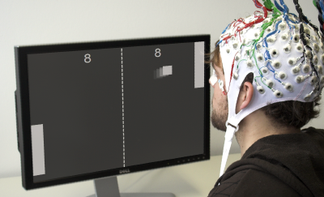
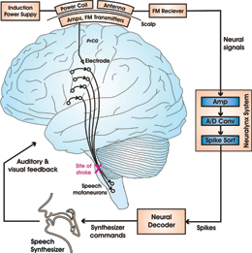
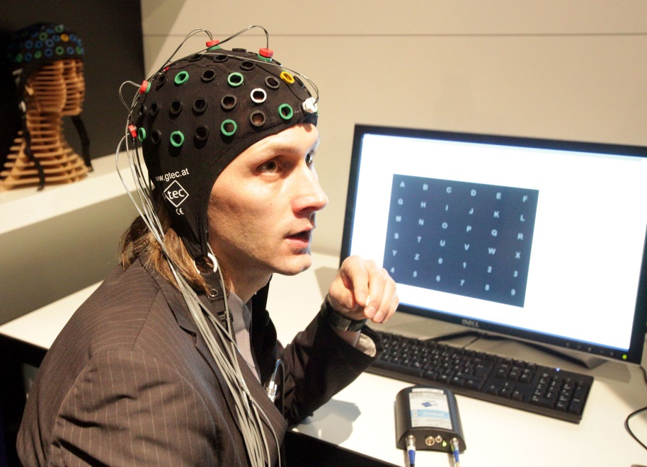
Future of mobile technology – 10 Years
Notes:
Brain-computer interfacing – Researchers have been working for decades now on brain-computer interfaces; advances have been made in the last decade such as allowing a person to play a game of ‘Pong’ via brainwaves captured through an Electroencephalogram. It is likely that within the next decade, we could have technology that allows us to control mobile devices with the power of thought.

Slide 26
Any questions?
Notes:
Thankyou for listening. Feel free to ask questions about any of the topics mentioned.

